Slide 1
Time code and the Alexa Mini
A guide by Bryan Cahill

Slide 2

Having issues getting the Alexa Mini to read time code?
This simple guide is intended to help alleviate many of the issues I have witnessed regarding the Alexa Mini and time code on student productions.

Slide 3
Start by setting the time code of your primary clock!
Which piece of gear should be the master or primary? You get to choose! In general, it should be your recorder if it generates time code ie, the SD 633, 688, 664, MixPre3II, MixPre6II, and MixPre10II. If your recorder doesn’t generate time code, ie the MixPre3, your master will be one of the tentacles or a component of your Ambient TC Kit.
Make sure to determine the frame rate with the camera department and set your master time code rate accordingly. 23.976 fps is the most common rate.

Slide 4
Synch all other time code generators to the primary.
Whichever piece of gear you have chosen as the primary, all other sources must be locked or synched to it. This will include Tiny Lock-its, Nanos, Tentacles, Smart Slate, etc. Make sure they are all reading the same time code.

Slide 5
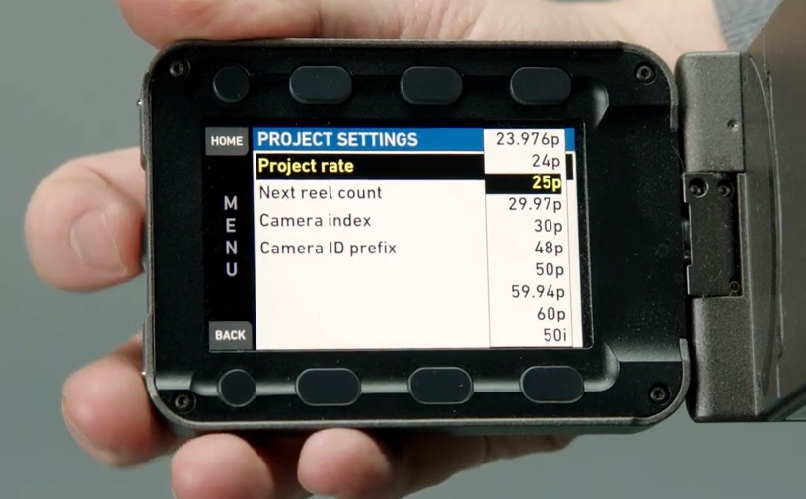
Time to teach that camera who’s boss!
There are two folders in the menu of the Alexa Mini where the settings must be correct in order to have the camera successfully read time code.
From the Home Screen, press the time code button.
If the project rate is incorrect, press the project rate button and find the correct frame rate. (23.976 and 23.98 are used interchangeably in discussion but, both are actually referring to 23.976)

Slide 6
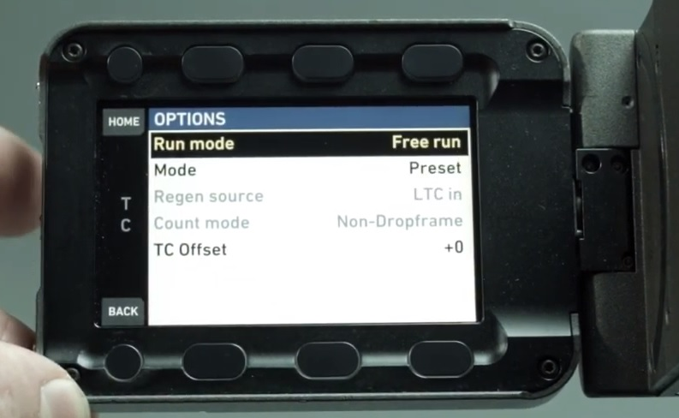
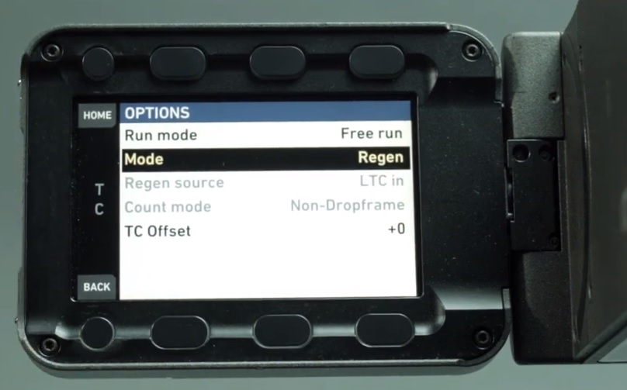
Now, go back to the time code screen and select “options”.
Make sure the “Run Mode” is in “Free Run.”
Then, in “Mode”, make sure the camera is in “Regen.”

Slide 7
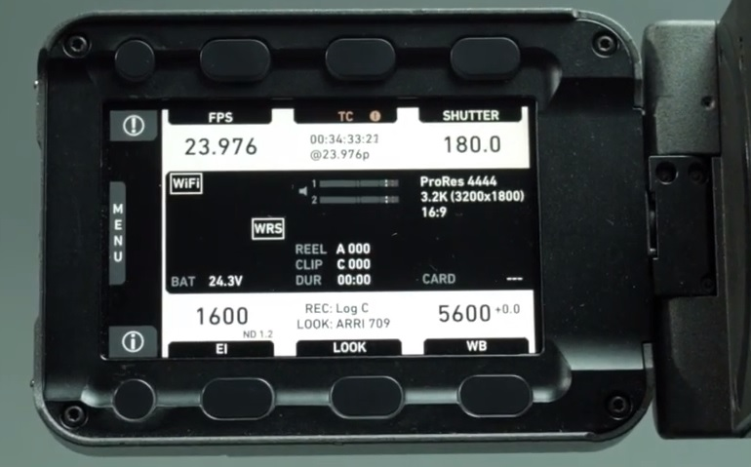
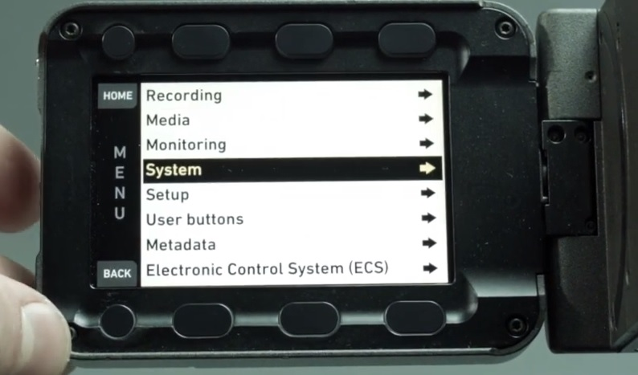
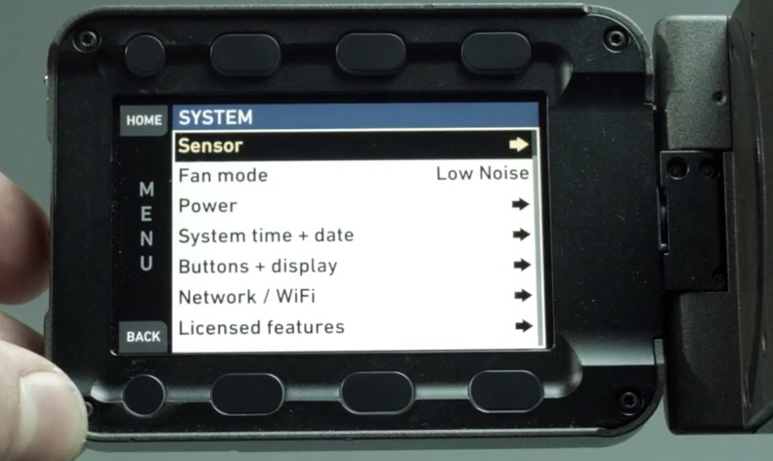
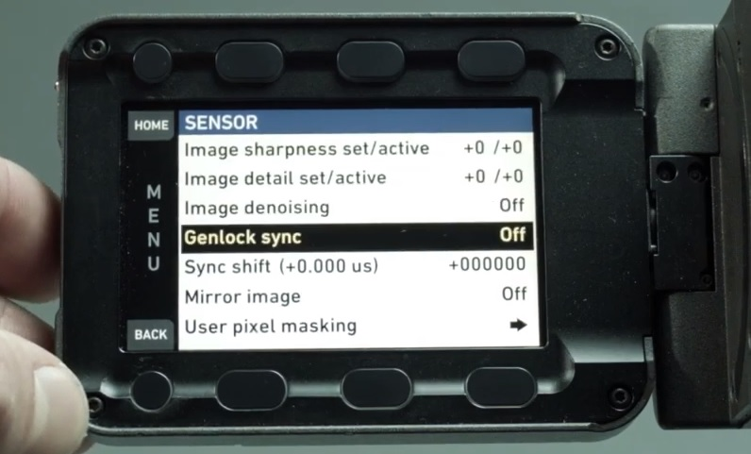
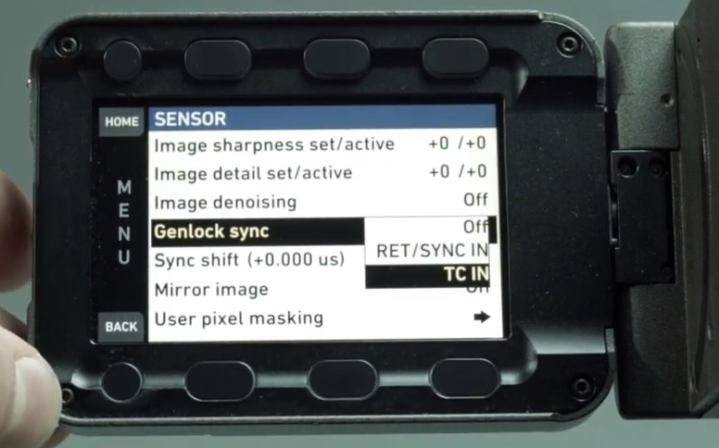
Good so far? That’s nice ‘cause here’s where it gets weird.
What
1. From the home screen, select menu.
2. Select “System”.
3. Select “Sensor”.
Select “Genlock sync.”
Finally, select “TC IN.”

Slide 8
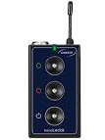
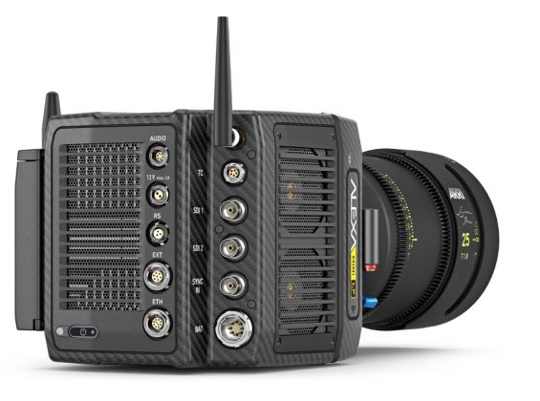
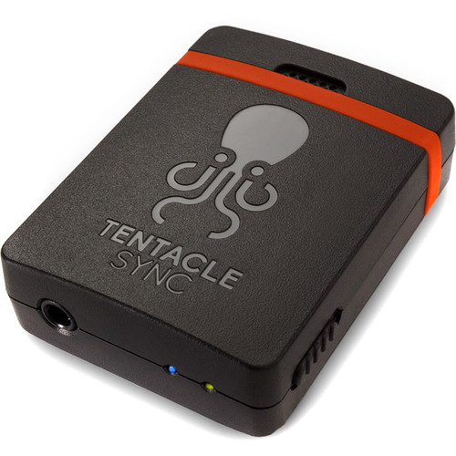
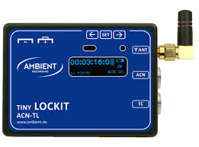
Now, plug your time code source into the Lemo connector on the Alexa mini and get ready for the magic!
At this point, it doesn’t matter whether you are using a Tentacle, a Tiny Lock-it, or a Nano. Once connected to the camera through the TC port, the Mini should read the correct time code almost instantaneously.

Slide 9
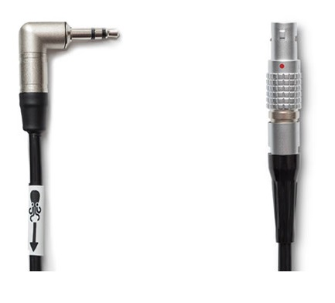
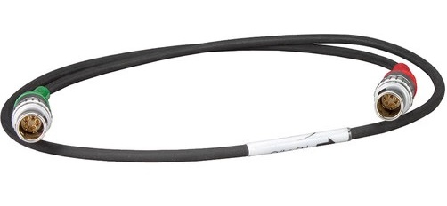
But, what if you can’t get the Alexa Mini to stop feeding time code back to the generator?
Both the Ambient time code kits and the Tentacle Kits have one-way cables to prevent the Alexa from jamming the generator with an incorrect time code signal.

Slide 10

That’s it!
Still not sure? Check out this helpful instructional video by our friends at Ambient.
https://www.youtube.com/watch?time_continue=18&v=WfGGcwG9NNQ&feature=emb_logo
Good luck!

